Slide 1
MultiView Control

Slide 2
MultiView Control
A mechanism to present multiple pieces of content from a single page
Steps:
  Drag a MultiView Control onto the page
  Drop one or more View Controls nested within the MultiView

Slide 3
Adding Multiview Control to .aspx Page
Add the <asp:MultiView> tag to your .aspx page file and then add one <asp:View> tag inside it for each separate view.
<asp:MultiView ID="MultiView1" runat="server">
<asp:View ID="View1" runat="server">...</asp:View>
<asp:View ID="View2" runat="server">...</asp:View>
<asp:View ID="View3" runat="server">...</asp:View>
</asp:MultiView>

Slide 4
Adding Multiple Views
Inside the <asp:View> tag, you add the HTML and web controls for that view.
<asp:MultiView ID="MultiView1" runat="server" ActiveViewIndex="0">
<asp:View ID="View1" runat="server">
<b>Showing View #1<br />
<br />
<asp:Image ID="Image1" runat="server“ ImageUrl="./cookies.jpg" /></b>
</asp:View>
<asp:View ID="View2" runat="server">
<b>Showing View #2</b><br />
<br />
Text content.
</asp:View>
<asp:View ID="View3" runat="server">
<b>Showing View #3</b><br />
<br />
<asp:Calendar ID="Calendar1" runat="server"></asp:Calendar>
</asp:View>
</asp:MultiView>

Slide 5
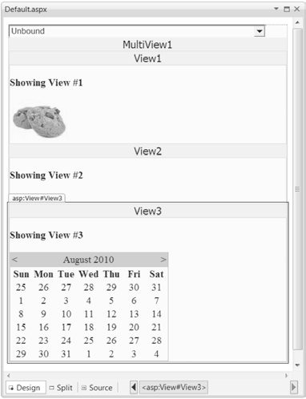
Designing multiple views

Slide 6
Designing multiple views
MultiView.ActiveViewIndex determines what view will be shown. Default value is -1.
Example that binds the list of views to a list box:-
Protected Sub Page_Load( ByVal sender As Object, ByVal e As System.EventArgs) Handles Me.Load
If Not Page.IsPostBack Then
DropDownList1.DataSource = MultiView1.Views
DropDownList1.DataTextField = "ID"
DropDownList1.DataBind()
End If
End Sub

Slide 7
Switching views with a list control
The code that sets the current view based on the list index:
Protected Sub DropDownList1_SelectedIndexChanged(
ByVal sender As Object, ByVal e As System.EventArgs
) Handles DropDownList1.SelectedIndexChanged
MultiView1.ActiveViewIndex = DropDownList1.SelectedIndex
End Sub

Slide 8
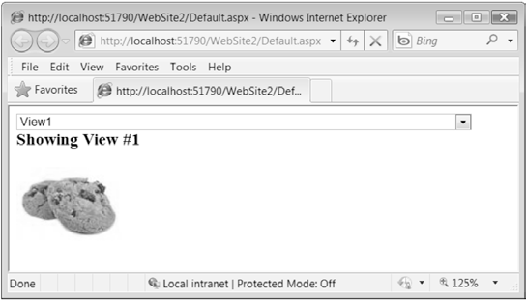
Switching views with a list control

Slide 9
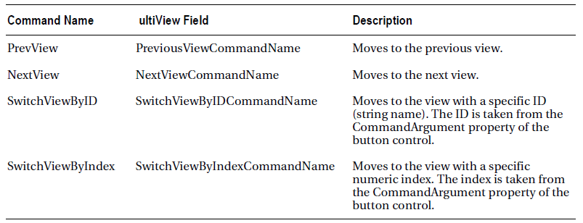
Recognized Command Names for the MultiView

Slide 10
NextView and PreView command names examples
Example:
Add this button to your first two views:
<asp:Button ID="cmdViewXNext" runat="server" Text="Next >" CommandName="NextView" />
And add this button to your second and third views:
<asp:Button ID="cmdViewXPrev" runat="server" Text="< Prev" CommandName="PrevView" />

Slide 11
Example
Create a MultiView Control with 3 different views based on values from a RadioButtonList rblView, with the following options:
  Nothing to display (value -1)
  First (Cyprus)
  Second (Paphos)
  Third (Venus)
  Fourth (Mallorca)

Slide 12
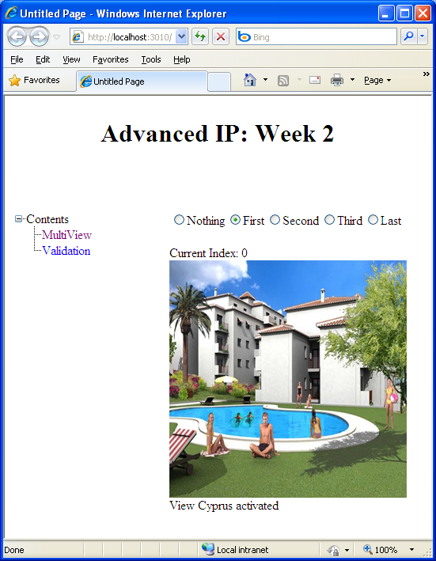

Slide 13
<asp:RadioButtonList AutoPostBack="True" ID="rblView"
OnSelectedIndexChanged="rblView_SelectedIndexChanged"
RepeatDirection="Horizontal" runat="server">
<asp:ListItem Value="-1">Nothing</asp:ListItem>
<asp:ListItem Value="0" Selected="True">First</asp:ListItem>
<asp:ListItem Value="1">Second</asp:ListItem>
<asp:ListItem Value="2">Third</asp:ListItem>
<asp:ListItem Value="3">Last</asp:ListItem>
</asp:RadioButtonList>
<br />
Current Index:
<asp:Label ID="lblCurrentIndex" runat="server"></asp:Label>

Slide 14
<asp:MultiView ID="MultiView1" runat="server" ActiveViewIndex="0" OnActiveViewChanged="MultiView1_ActiveViewChanged">
<asp:View ID="Cyprus" runat="server" OnActivate="ActivateView" OnDeactivate="DeactivateView">
<asp:Image ID="Image1" runat="server" Height="300px" ImageUrl="~/images/cyprus golf.jpg" Width="300px" /></asp:View>
<asp:View ID="Paphos" runat="server" OnActivate="ActivateView"
OnDeactivate="DeactivateView">
<asp:Image ID="Image2" runat="server" Height="300px" ImageUrl="~/images/paphos.jpg"
Width="300px" /></asp:View>
<asp:View ID="Venus" runat="server" OnActivate="ActivateView"
OnDeactivate="DeactivateView">
<asp:Image ID="Image3" runat="server" ImageUrl="~/images/venus.jpg" /></asp:View>

Slide 15
Functions Needed:
Main:
  rblView_SelectedIndexChanged
  ActiveView
  DeactiveView
  MultiView1_ActiveViewChanged
Additional:
  Page_PreRender

Slide 16
